Slide 1
Retail Inventory Management and Forecasting
Presented by:
Mahmoud Fahim
Mohamed Sherif
Randa Mostafa
Sara Shaaban
Shaimaa Tarek
Sherief Saied

Slide 2
Project Overview
This project focuses on building a comprehensive data solution for retail inventory management, starting from database design to advanced forecasting and deployment.
The initial phase involves designing a relational SQL database to manage inventory, sales, and supplier data, providing a robust foundation for data management.
Following this, a data warehouse is implemented to consolidate data using ETL processes, enabling efficient data reporting and analysis.

Slide 3
Project Overview
The project progresses into predictive modeling by building inventory demand forecasting models with Python, leveraging Azure's data services for scalability.
Finally, the project integrates MLOps for model management and deploys the forecasting system as a web service, ensuring its real-world applicability in supporting decision-making and automating inventory management processes.
This end-to-end solution showcases the integration of database systems, analytics, and cloud technologies to deliver actionable insights and efficient data handling.

Slide 4
Project Pipeline

Slide 5
Django Web App
SQL Server Database
Populate Database
Deployment (Azure Services)
Data Warehouse
Reporting using Power BI
Forecasting Using Python Model

Slide 6
Software Requirements
Django Web Framework
MS SQL Server
Azure Cloud Service
Python 3.9 and above
Pandas, Stat Model, Sklearn.
MS Power BI
Version Control: Github
AI Tool “ Chat GPT – Copilot – Gemini”
MS Excel

Slide 7
Project Development
01
02
03
04
Django Web App
SQL Database
Populated Database
Azure Deployment
05
06
Github Pipeline Deployment
Data Warehouse Pipeline
07
08
Data Analysis
Forecasting Model

Slide 8
Django Web App
01

Slide 9
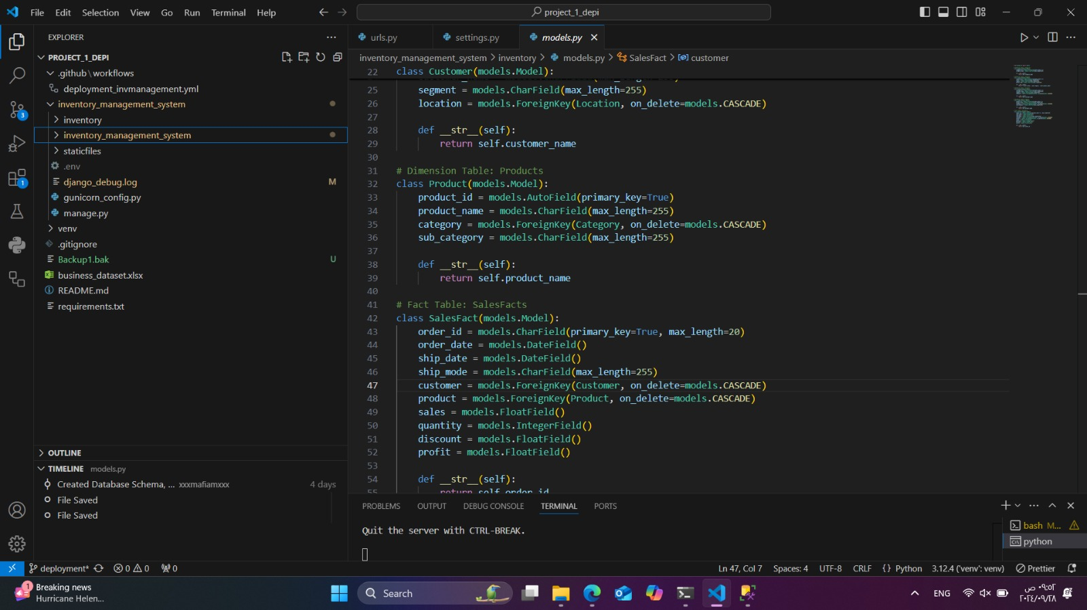

Slide 10
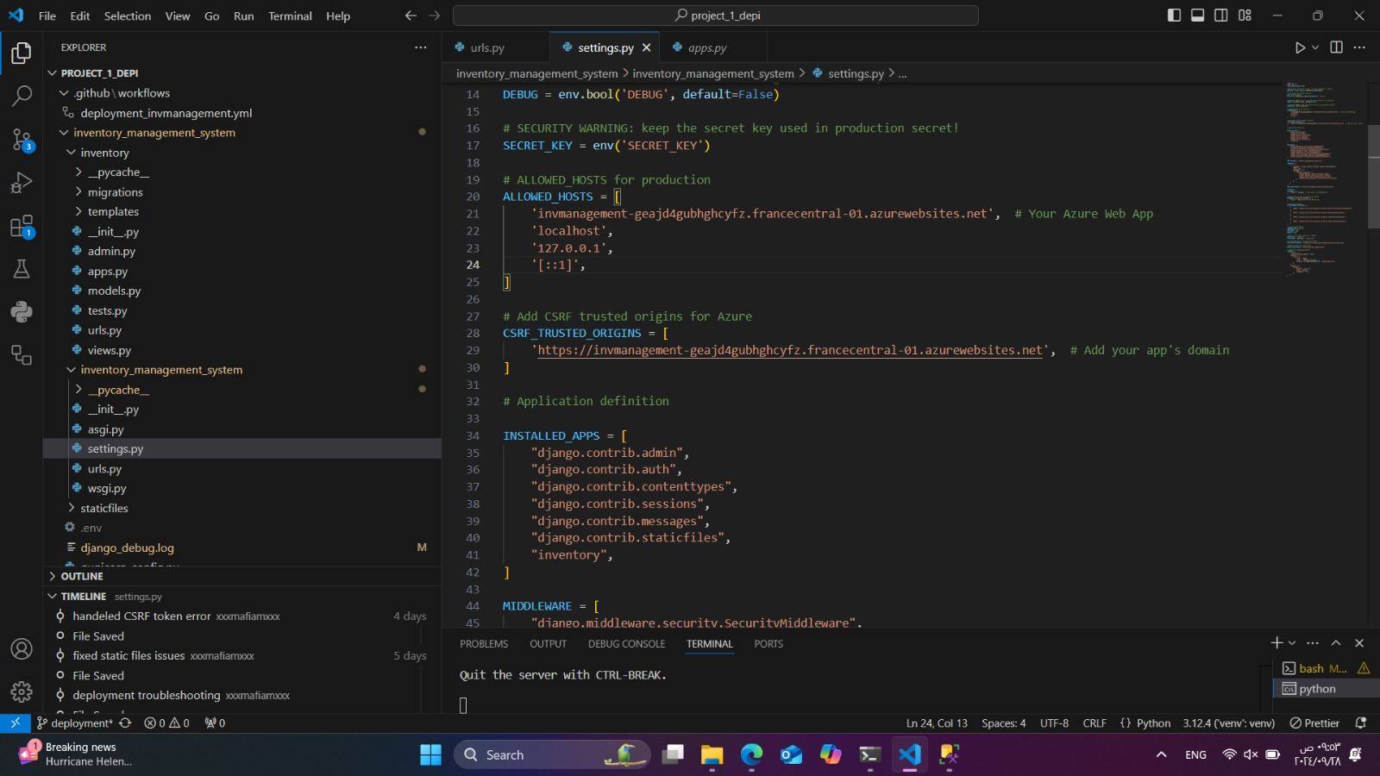

Slide 11
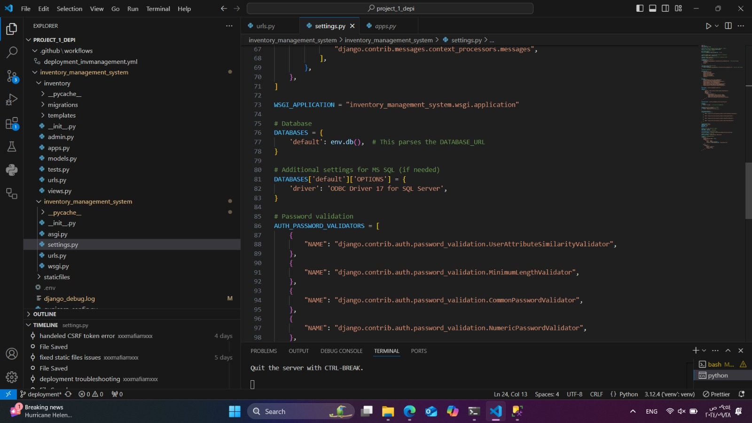

Slide 12
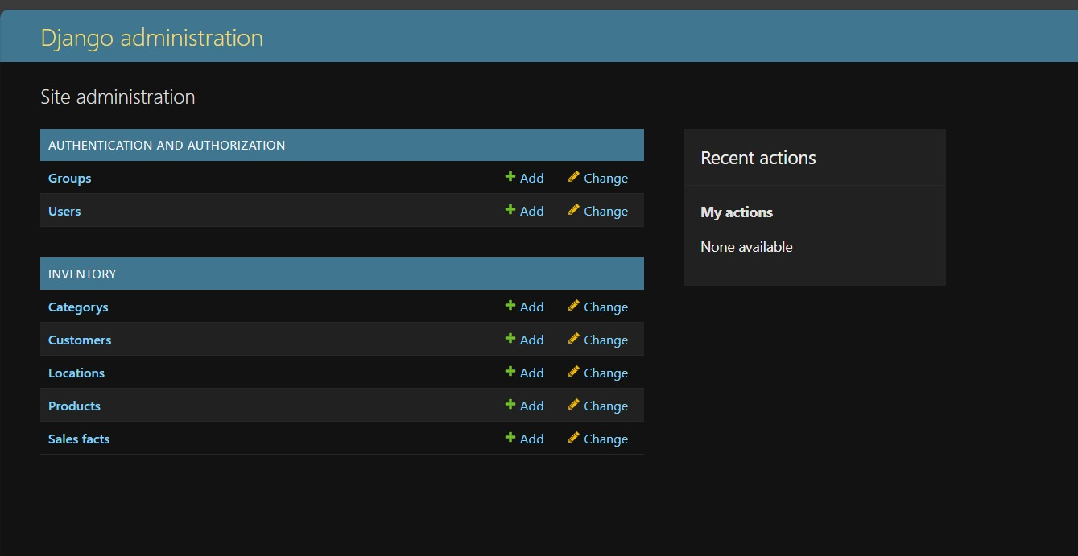
Django App Frontend

Slide 13
SQL Database
02

Slide 14
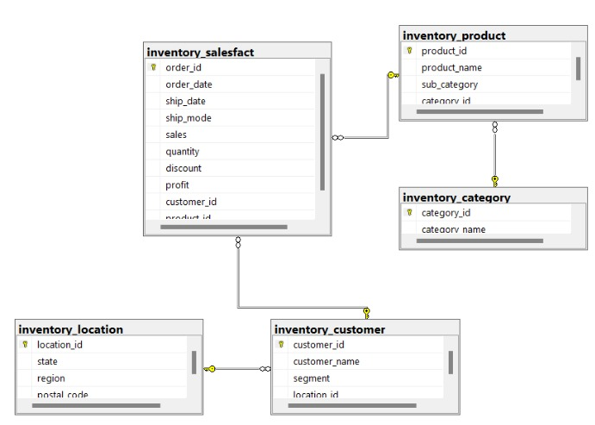
Database Schema

Slide 15
Polpulated Database
03

Slide 16
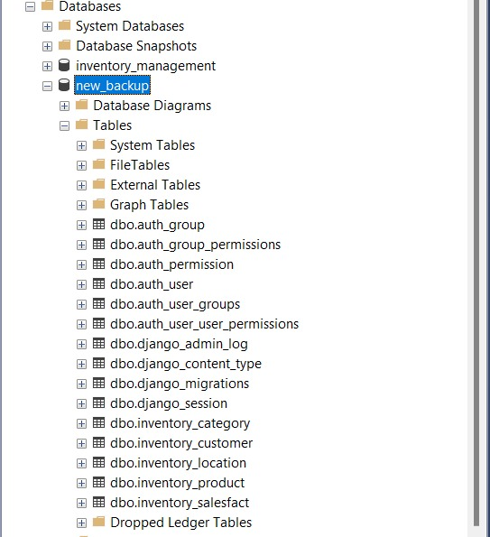
Database Tables

Slide 17
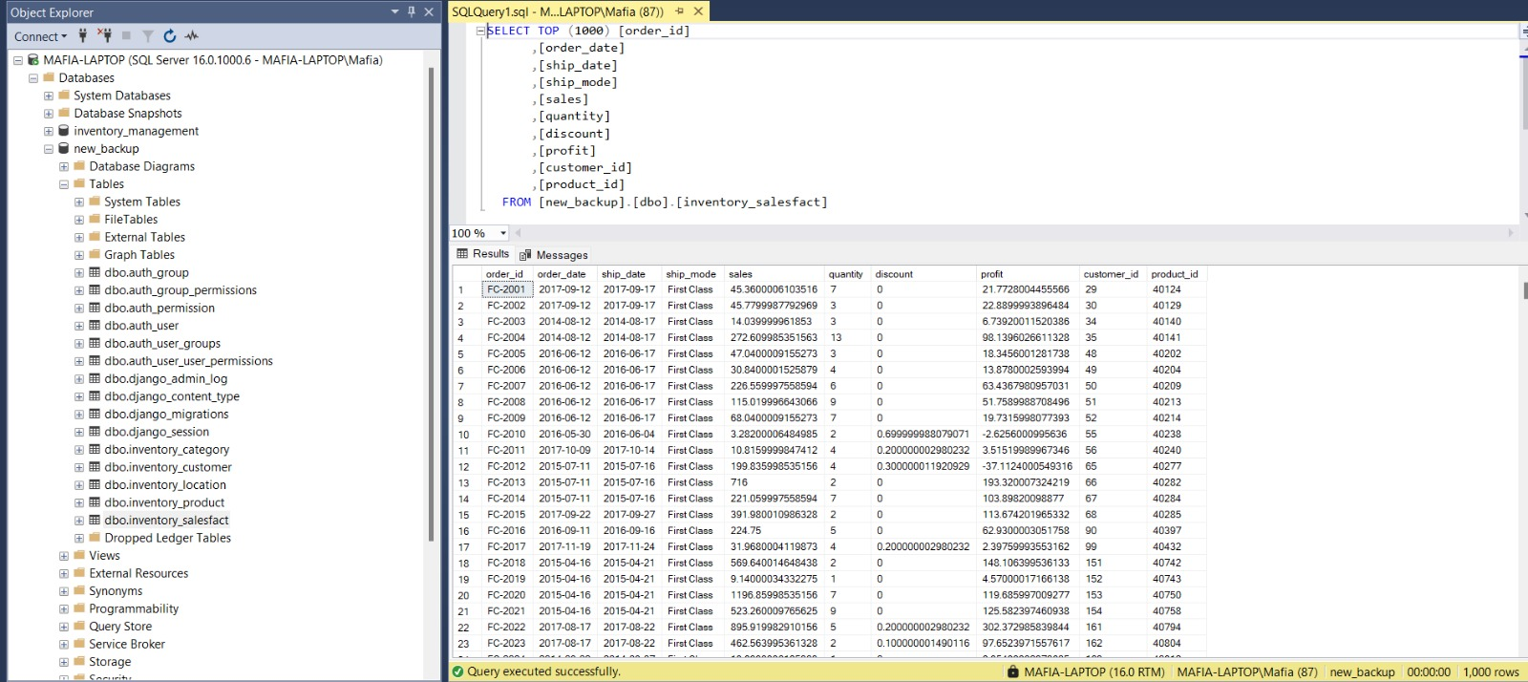
Populated Tables

Slide 18
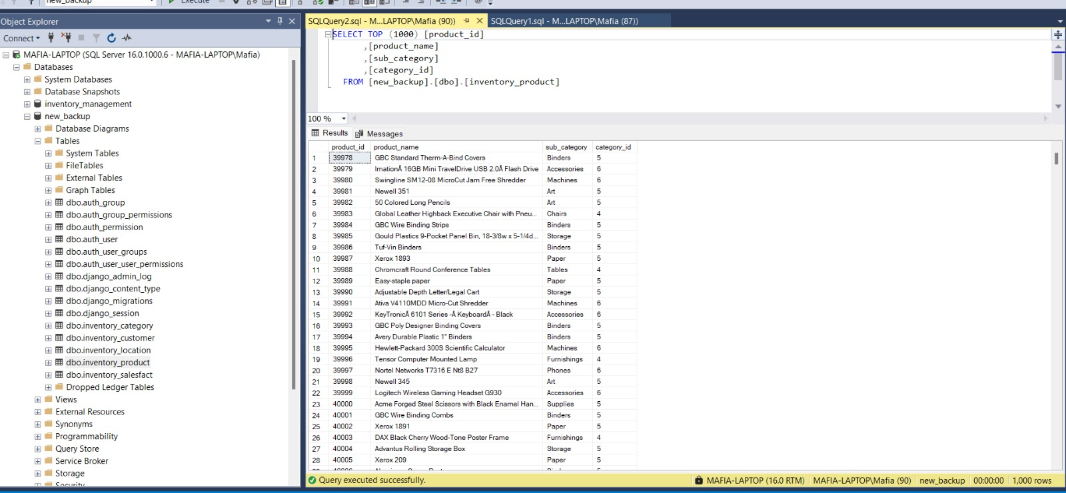
Populated Tables

Slide 19
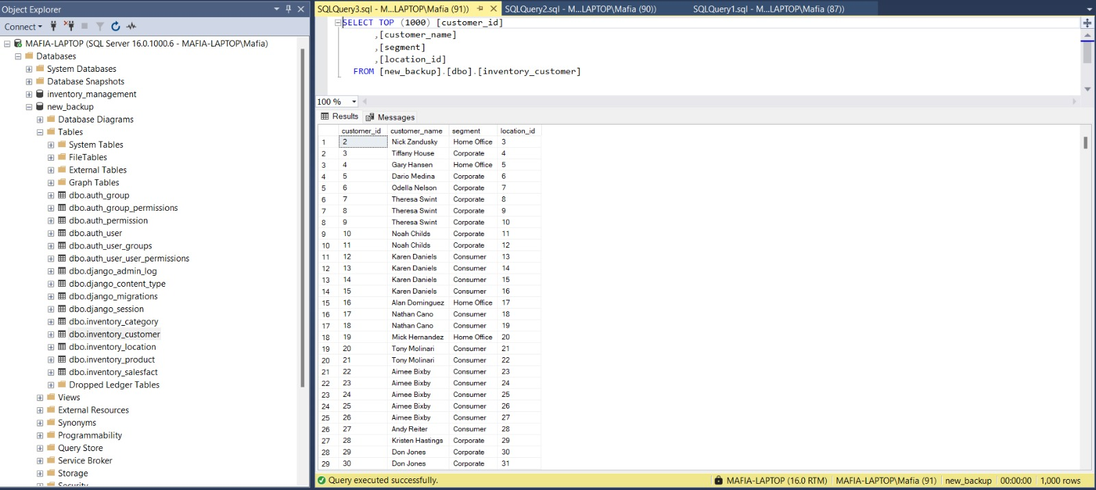
Populated Tables

Slide 20
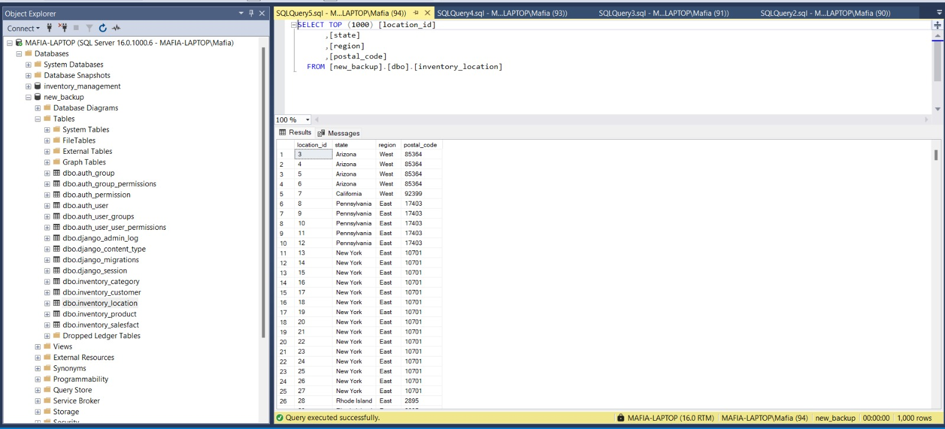
Populated Tables

Slide 21
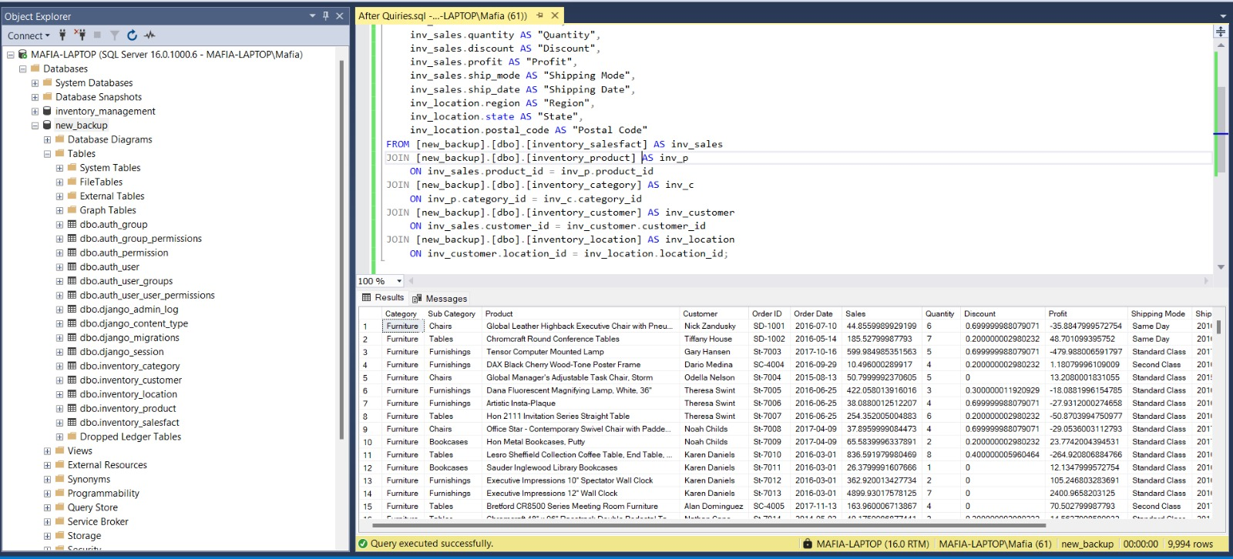
Sales Analysis Query

Slide 22
Azure Deployment
04

Slide 23
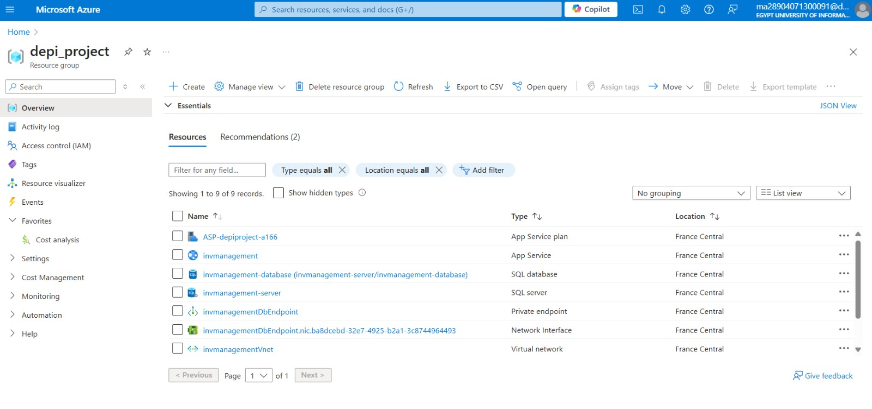
Azure Resource Group Setup

Slide 24
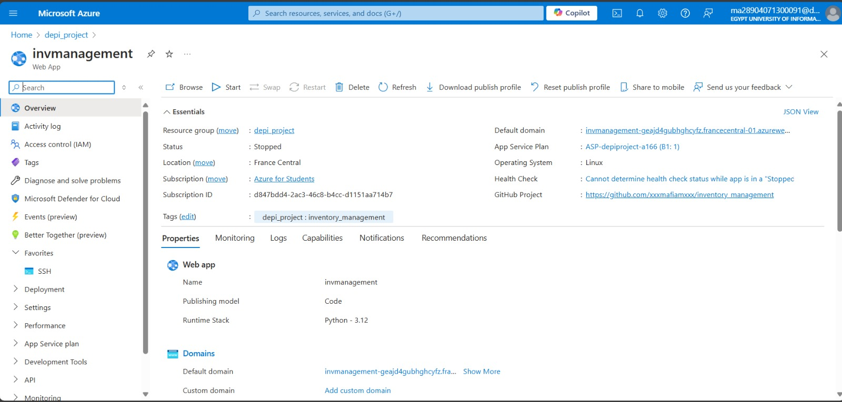
Azure Resource Group Setup

Slide 25
Github Pipeline deployment
05

Slide 26
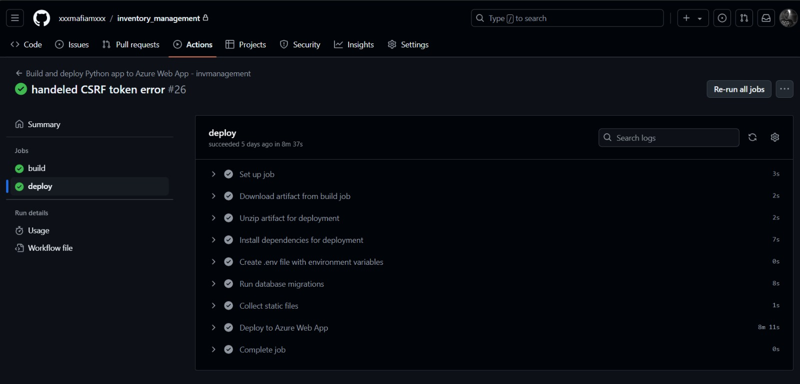
Github Pipeline Deployment

Slide 27
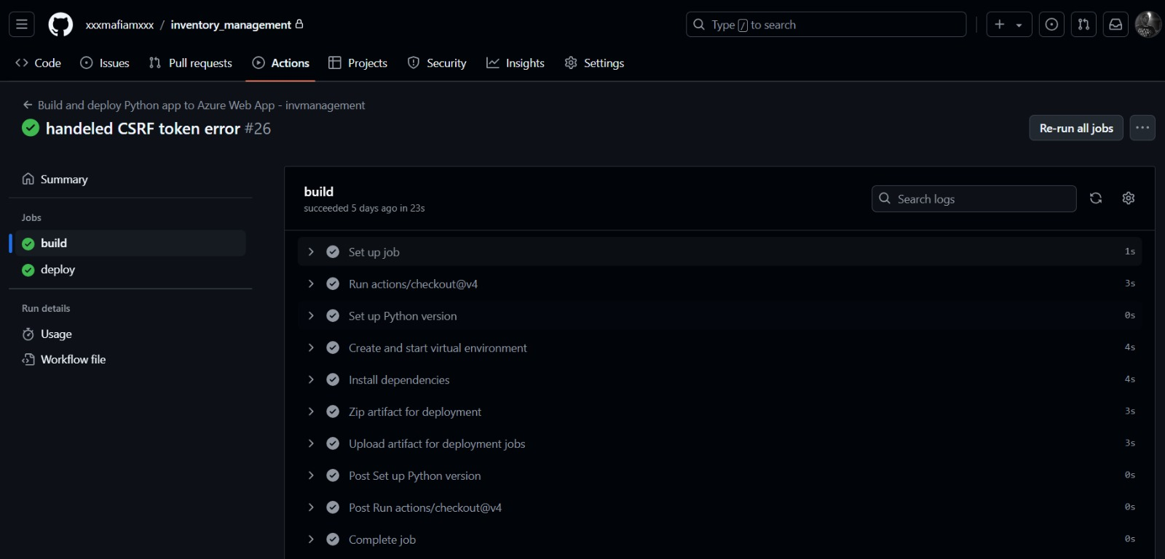
Github Pipeline Deployment

Slide 28
Data Warehouse Pipeline
06

Slide 29
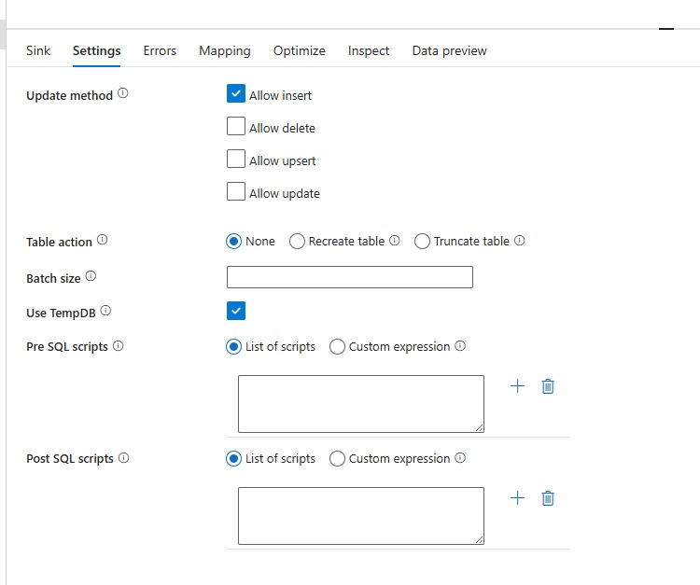
Data warehouse pipeline

Slide 30
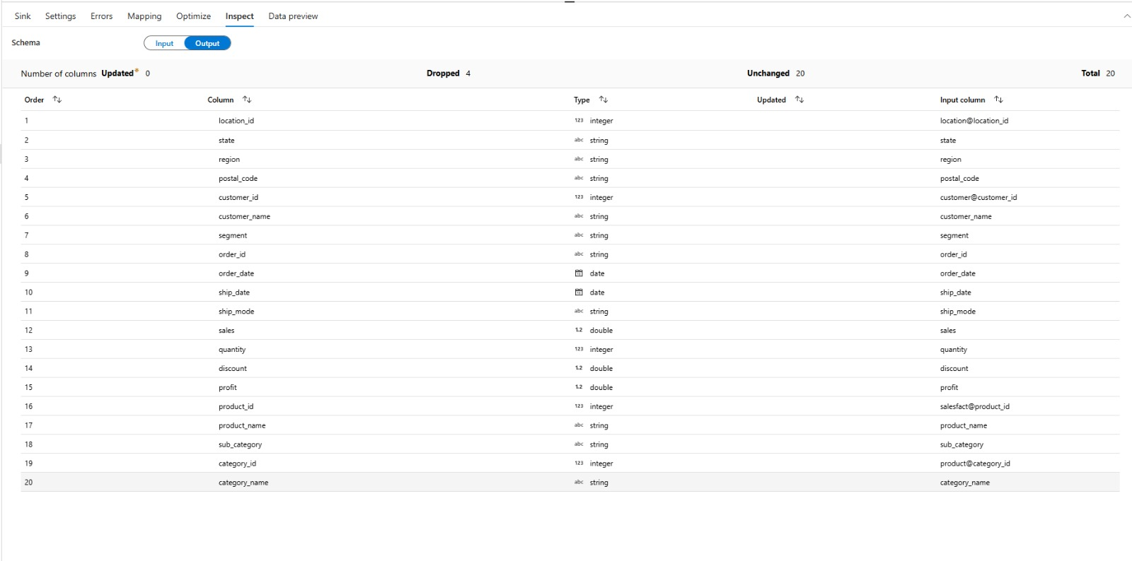
Data warehouse pipeline

Slide 31
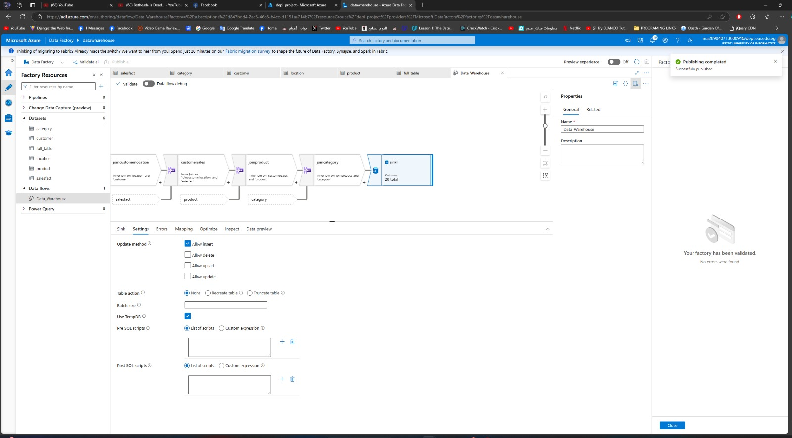
Data warehouse pipeline

Slide 32
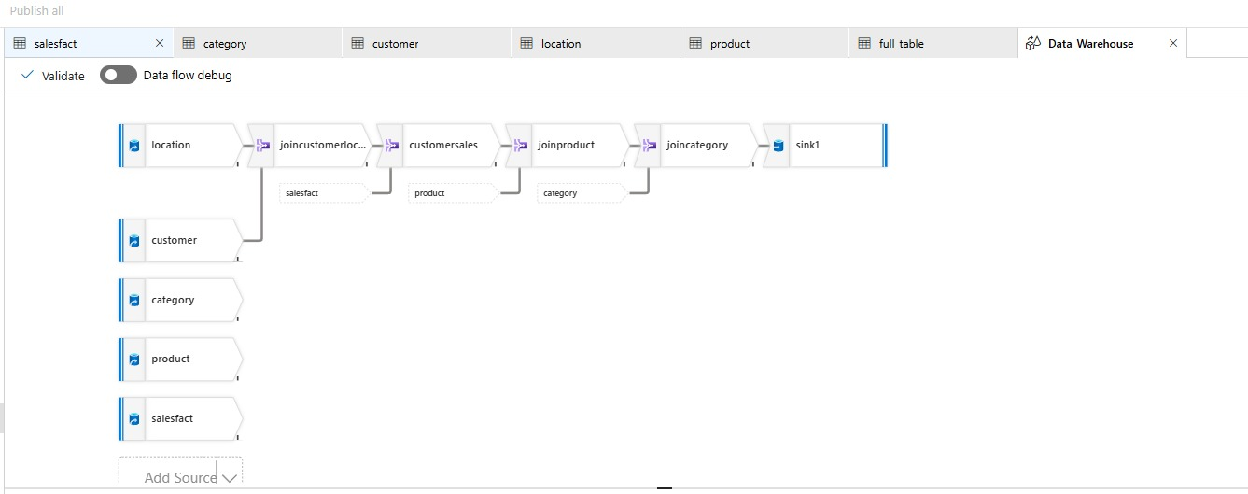
Data warehouse pipeline

Slide 33
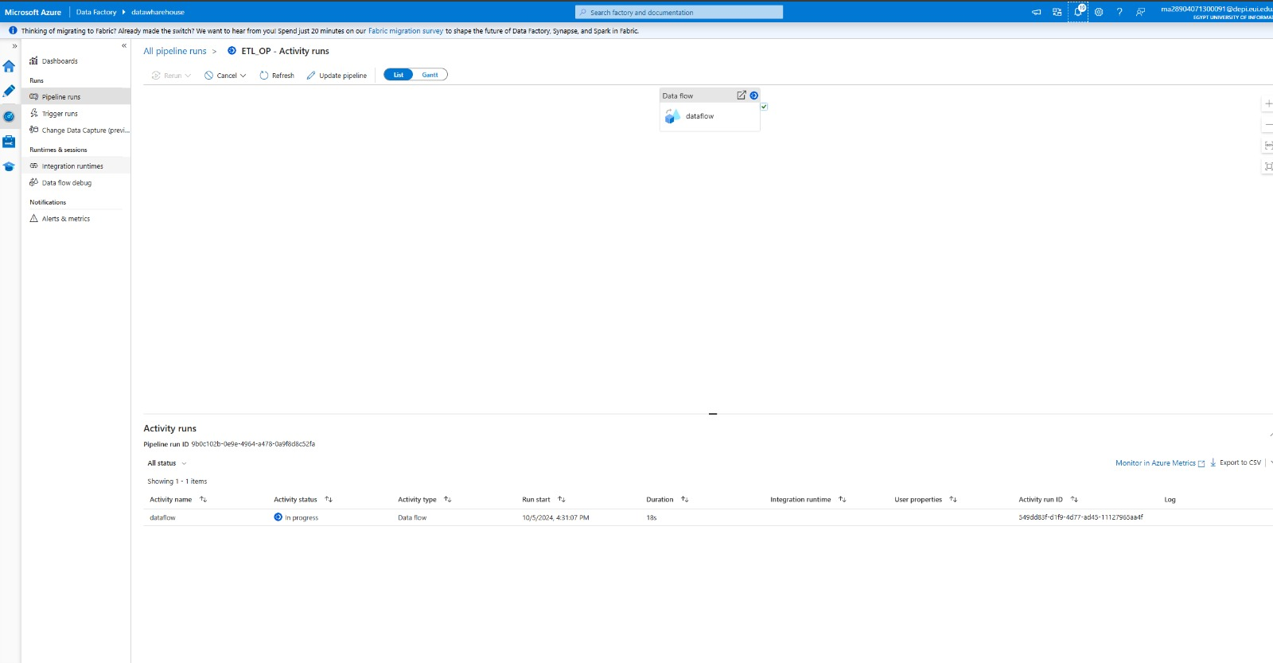
Data warehouse pipeline

Slide 34
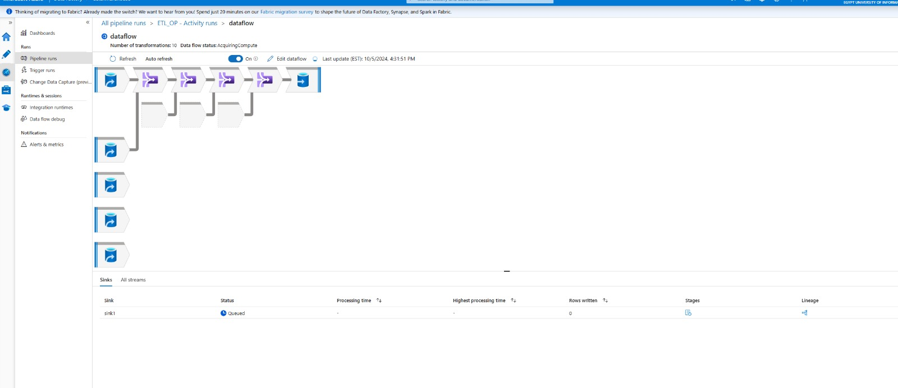
Data warehouse pipeline

Slide 35
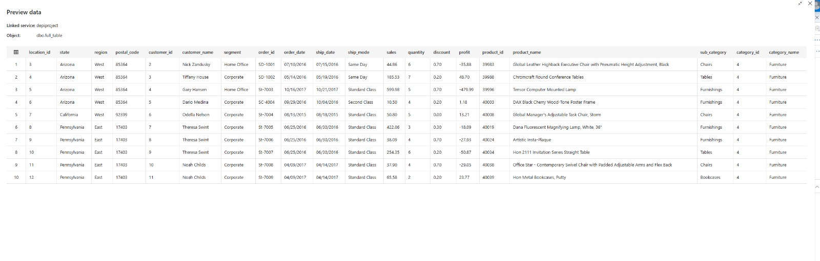
Result

Slide 36
Data Analysis
07

Slide 37
Overview

Slide 38
Customer Insights

Slide 39
Product and Shipping Insights

Slide 40
Profitability Analysis

Slide 41
Forecasting Model
08

Slide 42
Sales Forecasting

Slide 43
Sales Forecasting

Slide 44
Sales Forecasting

Slide 45
Profit Forecasting

Slide 46
Profit Forecasting

Slide 47
Profit Forecasting

